Slide 1
FREELANCING ECONOMY &
ONLINE EARNING
By:
Shaban Akhtar
Salbia Zainab
Syed Ali Hussani
Nafia Haroon

Slide 2
CONTENT
01 Introduction
02 Growth
03 Platforms
04 Work Types
05 Benefits
06 Challenges
07 Skills Required
08 Getting Started
09 Future of Freelancing
10 Conclusion

Slide 3

WHAT IS FREELANCING?
Work independently instead of being employed full-time
Offer skills as services to multiple clients
Projects are short-term or contract-based
Work is usually remote and global
Income depends on skills and demand

Slide 4

GROWTH OF FREELANCING
Increasing demand for remote work worldwide
Businesses prefer flexible, cost-effective hiring
Digital platforms make global work accessible
Popular among students and professionals
Continues to grow with technology

Slide 5


FREELANCING PLATFORMS
Online marketplaces connecting clients and freelancers
Provide secure payments and job listings
Build reputation through reviews and ratings
Popular platforms: Fiverr, Upwork, Freelancer
Make it easier to find work globally

Slide 6
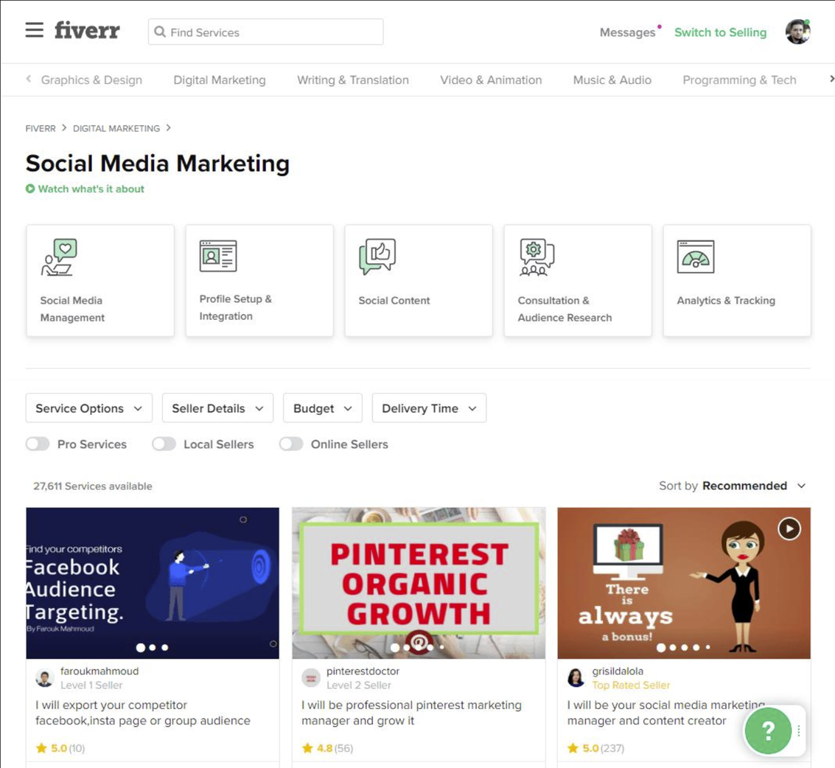
FIVERR OVERVIEW
Service-based platform using “gigs”
Freelancers set prices and offerings
Simple and beginner-friendly system
Best for quick and smaller projects
Strong focus on fast delivery

Slide 7
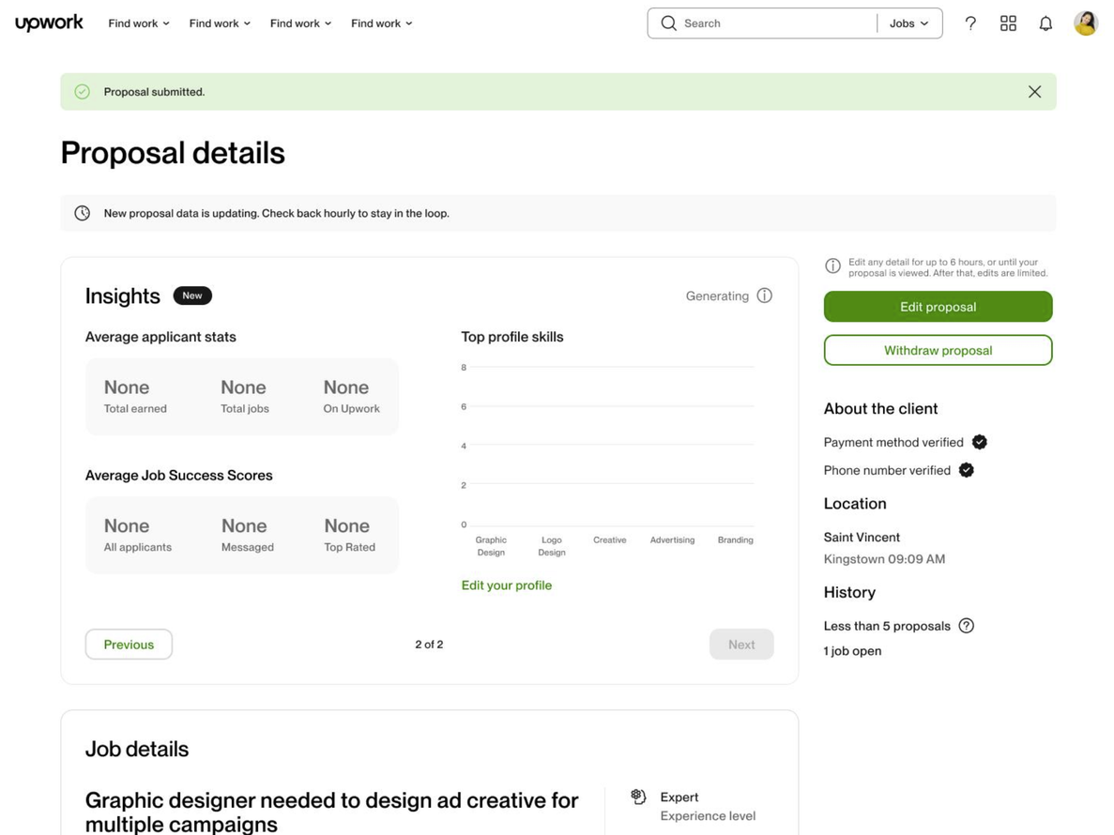
UPWORK OVERVIEW
Job-based platform with client postings
Freelancers submit proposals to apply
Suitable for long-term and professional work
Offers hourly and fixed-price projects
Strong competition but higher earning potential

Slide 8

Types of Freelancing Work
Graphic Design: logos, branding, UI/UX design
Content Writing: blogs, articles, copywriting
Web Development: websites, apps, coding
Digital Marketing: SEO, social media marketing
Video Editing: YouTube videos, ads, reels

Slide 9

FINANCIAL OPPORTUNITIES
Earn in foreign currencies (USD, EUR, etc.)
Exchange rate benefits for countries like Pakistan
Multiple clients = multiple income streams
Opportunity for passive income (digital products, templates)
Can scale income over time

Slide 10

EXAMPLE ROLES
Logo Designer: creates brand identities for businesses
Blog Writer: writes articles for websites
Frontend Developer: designs website interfaces
Social Media Manager: manages online presence and content

Slide 11

BENEFITS OF FREELANCING
Flexible working hours and schedule
Ability to work from home or anywhere
Opportunity to work with international clients
Unlimited earning potential based on skills
Continuous learning and skill development

Slide 12

CHALLENGES OF FREELANCING
High competition, especially for beginners
No fixed or stable monthly income
Difficulty in finding initial clients
Communication gaps with international clients
Lack of job security and benefits

Slide 13
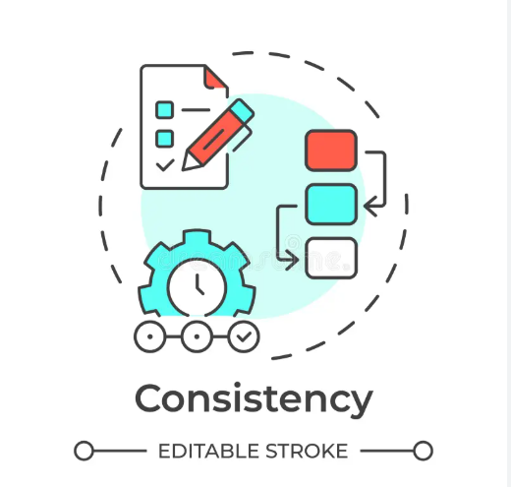
CONSISTENCY ISSUES
Irregular flow of projects and work
Income can fluctuate month to month
Requires strong self-discipline and motivation
Freelancers must constantly search for new clients
“Dry periods” can occur with no projects

Slide 14

SKILLS REQUIRED
Technical Skills – Knowledge of coding or relevant tools
Communication Skills – Clear interaction with clients
Problem-Solving Skills – Ability to handle challenges efficiently
Time Management – Managing multiple projects effectively

Slide 15
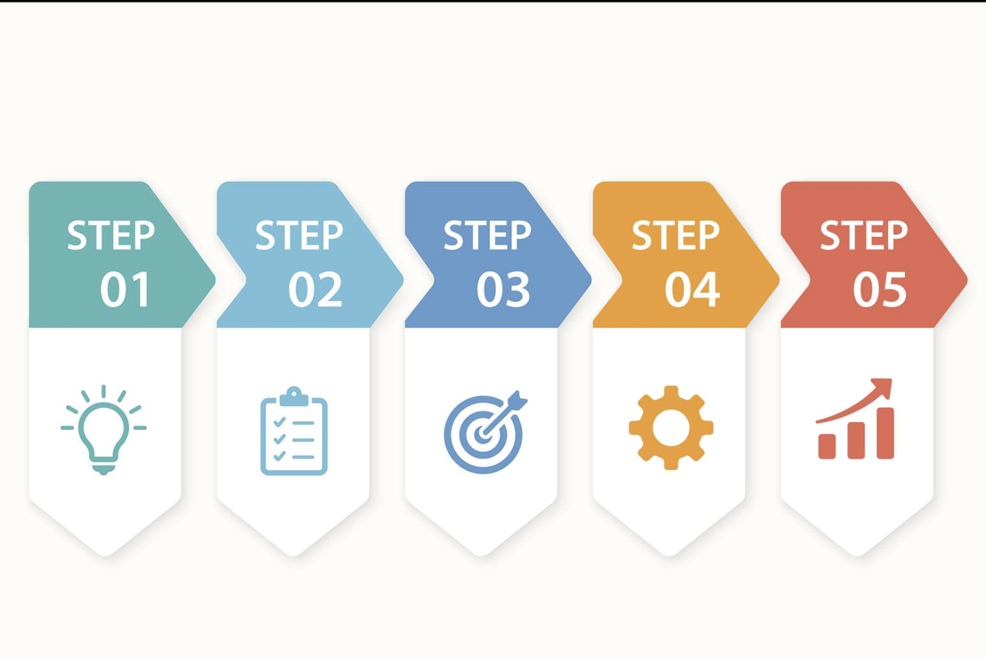
HOW TO START FREELANCING
Choose a Skill – Focus on a marketable ability
Create a Portfolio – Highlight your best work
Join Platforms – Set up professional profiles
Find Clients – Apply for jobs or list services
Deliver Quality – Build trust and long-term clients

Slide 16

TIPS FOR SUCCESS
Build a strong profile
Communicate clearly
Keep learning new skills
Deliver quality work
Stay consistent

Slide 17

FUTURE OF FREELANCING
Growing digital economy
More remote work opportunities
Rise of AI and new technologies
Access to global clients
Strong future growth

Slide 18
CONCLUSION
Flexible way of working
Multiple income opportunities
Growing career option
Requires skills and consistency

Slide 19
QNA SESSION
Q1
HAVE YOU EVER TRIED FREELANCING?
Q2
HOW DO YOU THINK AI IS CHANGING FREELANCING?

Slide 20
THANK
YOU

